Slide 1
21CSC204J-Design and Analysis of Algorithms Traffic Management Control using Greedy Algorithm

Slide 2
INTRODUCTION
Traffic congestion is a pervasive issue in urban areas, leading to increased travel times, fuel consumption, and environmental pollution. Efficient traffic management and control are essential for alleviating congestion and improving the overall flow of traffic. In this context, the use of algorithms to optimize traffic signal timings plays a crucial role in enhancing the efficiency of traffic flow at intersections.
This code demonstrates a simple implementation of a greedy algorithm for optimizing traffic signal timings in a network of intersections. The goal is to minimize overall waiting times for vehicles at each intersection by dynamically adjusting the signal timings based on current traffic conditions.
The algorithm iteratively evaluates and adjusts the signal timings at each intersection, prioritizing the reduction of waiting times for vehicles queued at the intersection. By making locally optimal adjustments at each step, the algorithm aims to converge to a set of signal timings that minimize overall waiting times across the entire network.

Slide 3

THE IDEA
The idea behind the steps outlined is to provide a systematic approach for utilizing the greedy algorithm to optimize traffic signal timings for a network of intersections. The steps are designed to guide the user through the process of defining the problem, implementing the algorithm, and evaluating the results

Slide 4
PROCEDURE TO BE USED
1. Define the Network of Intersections and Roads:
Before using the algorithm, you need to define the network of intersections and roads in the area of interest. This includes identifying the intersections and specifying the connections (roads) between them. Each intersection should be represented as a node in the network, and each road segment connecting two intersections should be represented as an edge.
2. Specify Initial Signal Timings:
Define the initial signal timings for each intersection in the network. The initial signal timings determine the duration of green, yellow, and red lights for each direction at the intersection. These initial timings can be based on factors such as historical traffic patterns, road capacities, and pedestrian crossing times.
3. Implement the Greedy Algorithm:
Implement the greedy algorithm for optimizing traffic signal timings. The algorithm iteratively evaluates and adjusts the signal timings at each intersection to minimize overall waiting times for vehicles. This involves calculating the waiting time for vehicles queued at each intersection based on the current signal timings and adjusting the signal timings using a greedy strategy to reduce waiting times.

Slide 5
PROCEDURE TO BE USED
4. Iterative Improvement:
Iterate the algorithm until no further reduction in waiting time can be achieved or until a termination condition is met. During each iteration, evaluate the waiting times at each intersection and adjust the signal timings accordingly. The greedy algorithm makes locally optimal adjustments at each step, aiming to converge to a set of signal timings that minimize overall waiting times across the network.
5. Terminate and Output:
Terminate the algorithm when no further improvement in waiting time can be achieved or when a termination condition is met. Output the final set of optimized signal timings for each intersection in the network. These optimized timings represent the dynamically adjusted signal timings that minimize overall waiting times for vehicles at each intersection.
6. Validation and Testing:
Validate the optimized signal timings through simulation or real-world testing. Evaluate the effectiveness of the optimized timings in improving traffic flow, reducing congestion, and enhancing the overall efficiency of the transportation system. Adjust parameters and fine-tune the algorithm as necessary based on feedback and performance metrics.

Slide 6
WORKING:
Starting Point: The program begins with a certain set of traffic signal timings at each intersection. These timings determine when the lights change from red to green and vice versa.
Assessment: It looks at the current situation at each intersection. This includes factors like how many cars are waiting, how long they've been waiting, and the flow of traffic from different directions.
Local Optimization: Based on this assessment, the program decides how to adjust the traffic signal timings. It aims to improve traffic flow at each individual intersection, even if it might not be the best solution for the entire road network.
Repetition: This process repeats over and over again. The program continually reassesses the situation at each intersection, makes adjustments to the traffic signal timings, and evaluates the impact of those changes.
Convergence: Eventually, after many iterations, the program aims to converge on a set of traffic signal timings that collectively minimize waiting times across the entire road network. Each intersection's signal timings work together to optimize traffic flow throughout the city.
So, the Greedy Algorithm is used in the program to iteratively tweak traffic signal timings at each intersection, aiming to improve traffic flow and reduce waiting times for drivers at that moment, without necessarily considering the entire road network all at once.

Slide 7
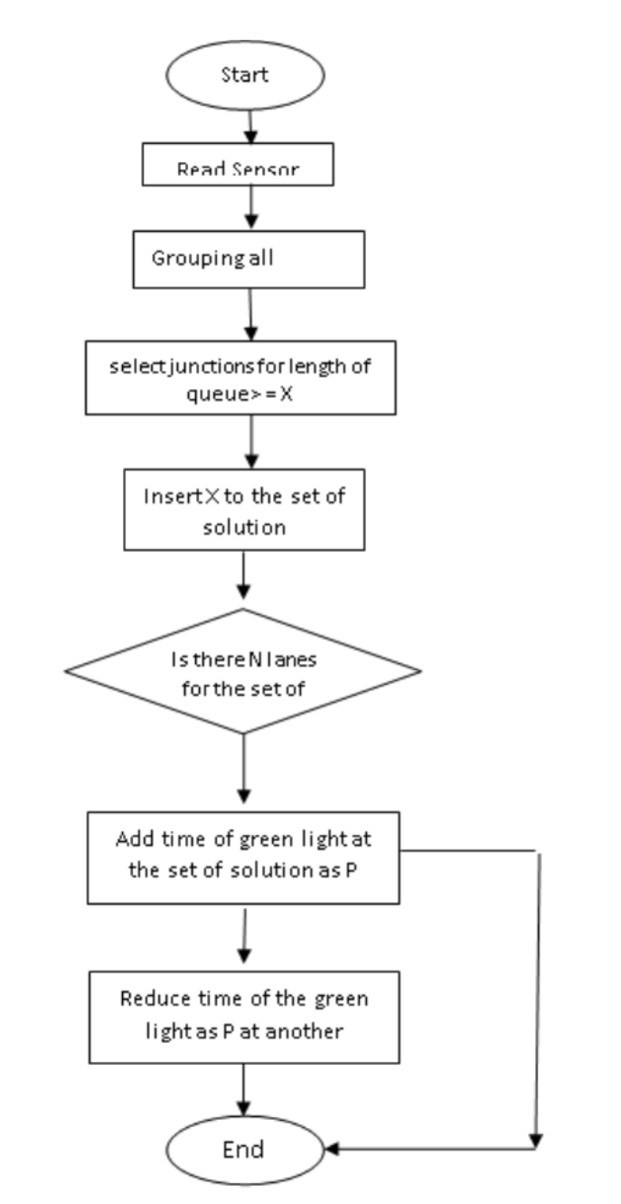
Greedy algorithm for smart traffic light
The sensor will read the traffic density and the data will be sent to Arduino. What is interpreted as a
sensor reads the length of the vehicle queue, greater or equal to X.
• X is a sensor that is greater or equal to level three. Then the sensor puts the value into the
resolution circuit, is there an N path in the solution set
N is a value greater or equal to the three that are in the set of solutions, then the next step is to
add time to a green light like P.
P is the amount of time that will be added to the green light at the intersection that has a queue of
vehicles on three or more sensors, and will reduce the green light time like P at another intersection

Slide 8
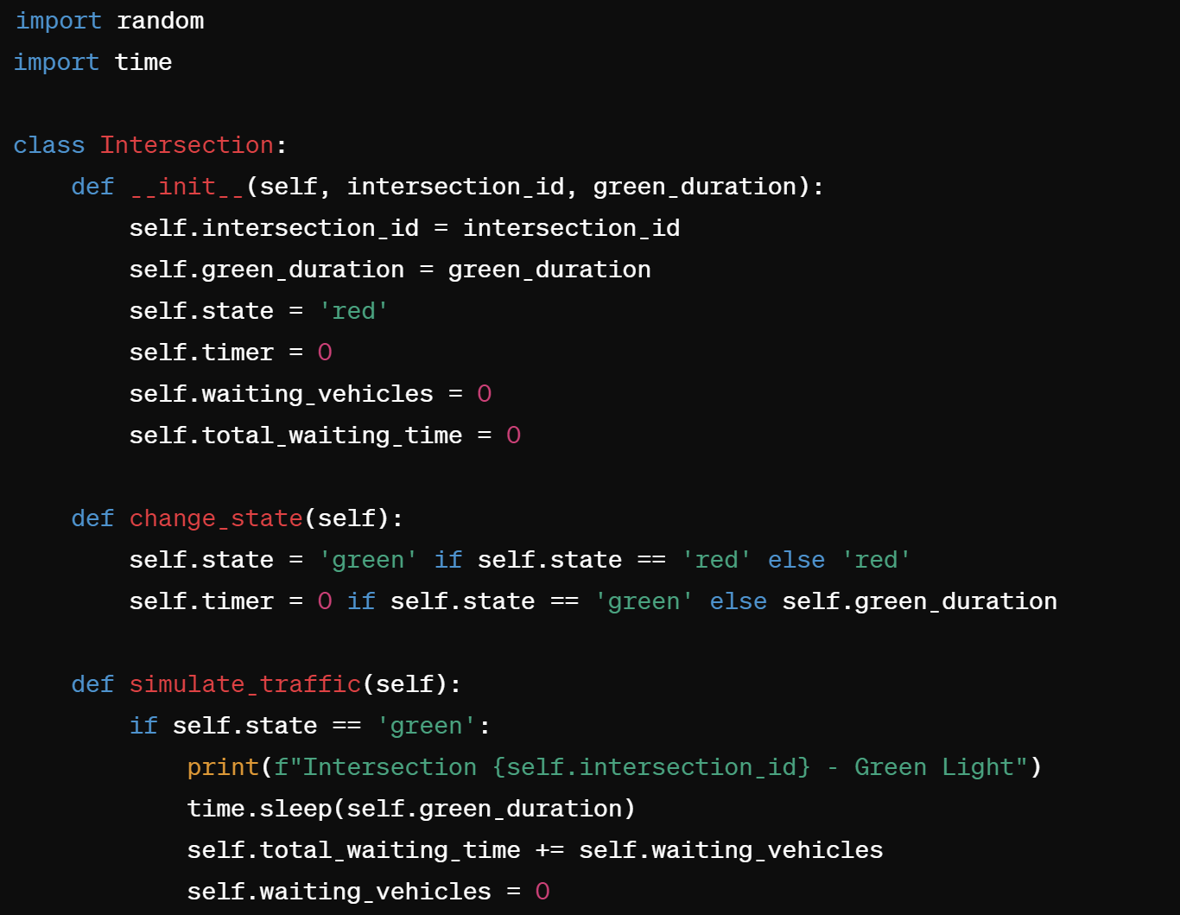
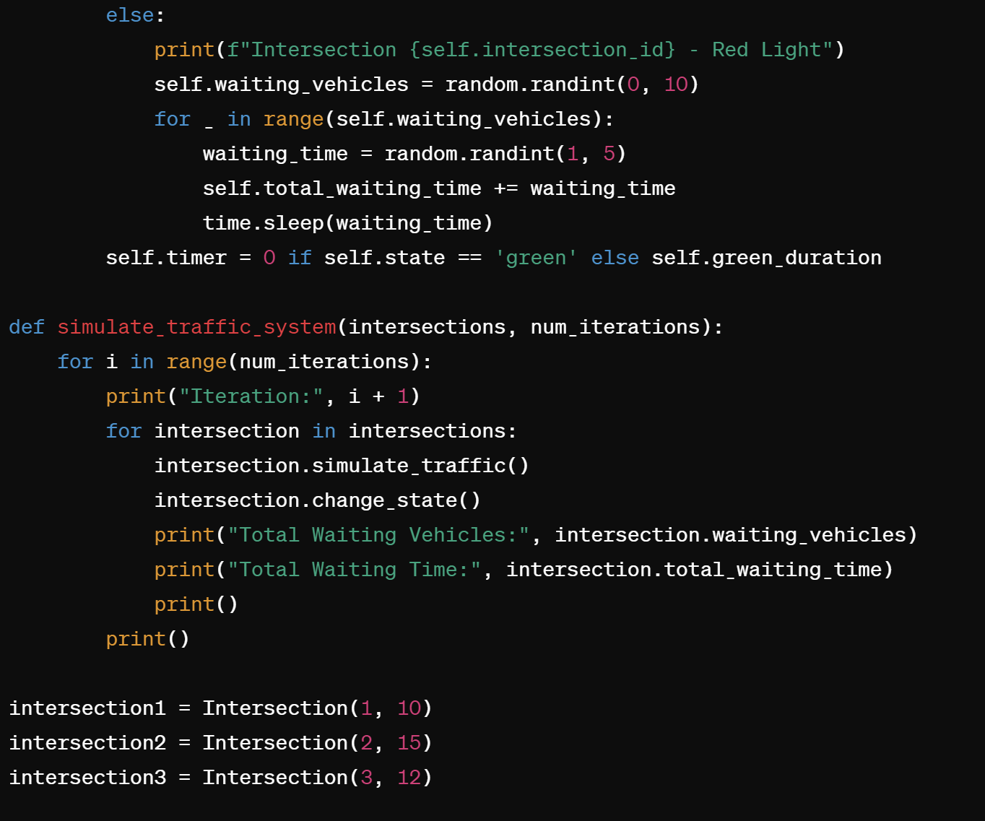
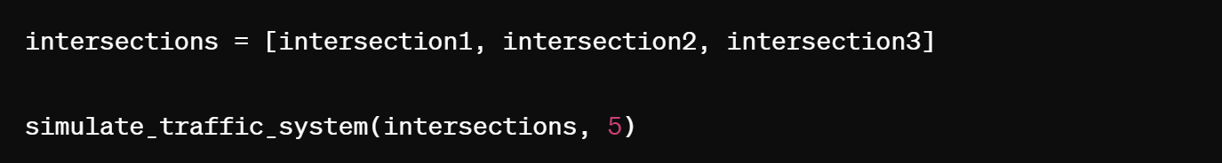
SAMPLE CODE:

Slide 9
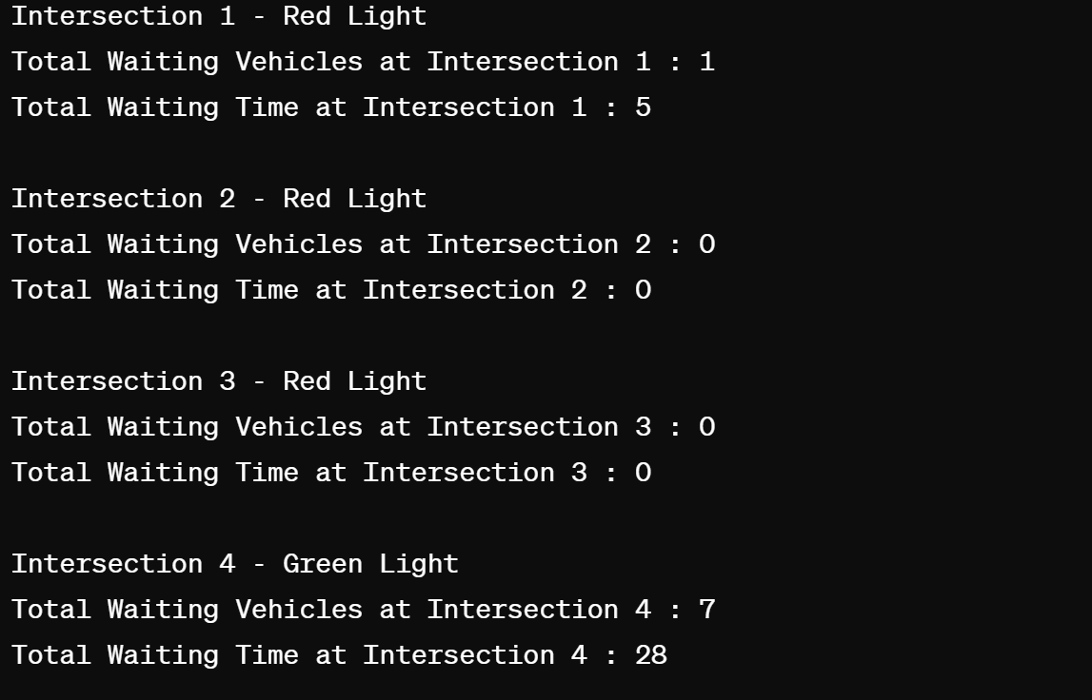
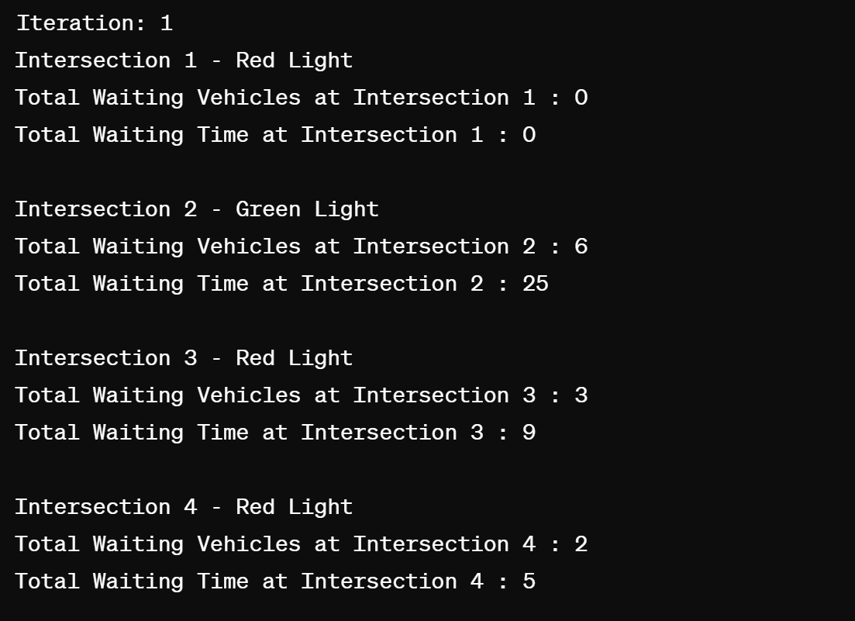
OUTPUT:

Slide 10
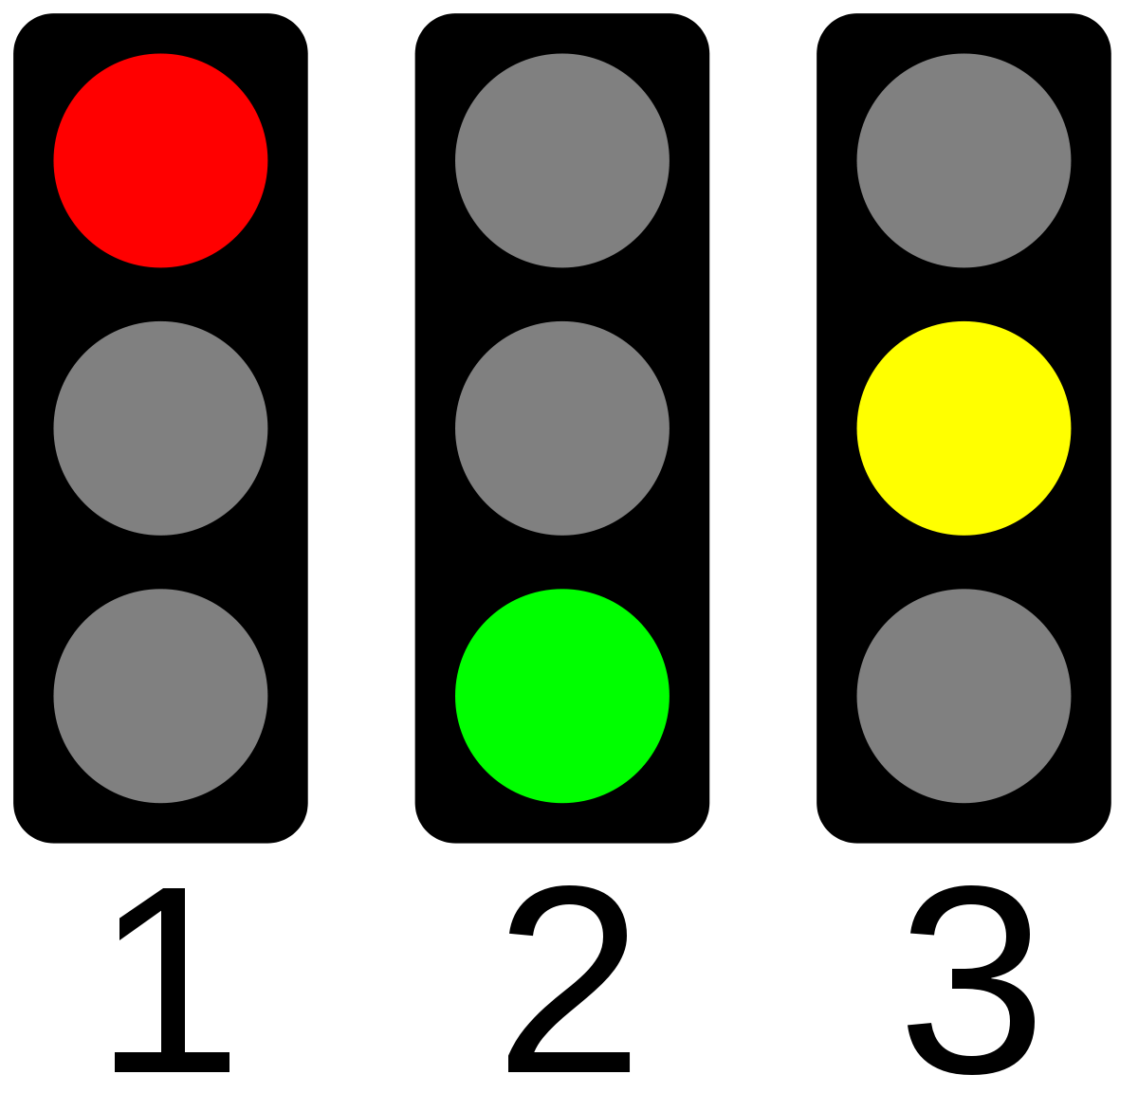
REAL WORLD APPLICATION:
Adaptive Traffic Signal Control Systems:
These systems use optimization algorithms to dynamically adjust signal timings at intersections based on real-time traffic conditions.
By analyzing data such as traffic volume, vehicle speed, and congestion levels, these systems can optimize signal timings to reduce traffic congestion and improve traffic flow.
Adaptive traffic signal control systems can help minimize delays, reduce travel times, and enhance overall traffic efficiency.
Intelligent Transportation Systems (ITS) Applications:
ITS applications integrate various technologies to gather, process, and disseminate real-time information related to transportation and traffic management.
Optimization algorithms play a crucial role in ITS applications by analyzing traffic data, optimizing route planning, and coordinating traffic signals.
These applications help improve traffic safety, reduce congestion, and enhance overall transportation efficiency by providing travelers and transportation agencies with timely and actionable information.

Slide 11
TIME COMPLEXITY
Best Case Time Complexity:
In the best case scenario, the algorithm iterates through each intersection once and performs constant-time operations to calculate waiting times and adjust signal timings. As a result, the time complexity of the algorithm is linear with respect to the number of intersections in the network.
Best Case Time Complexity: O(n), where n is the number of intersections.
Worst Case Time Complexity:
In the worst case scenario, the algorithm still iterates through each intersection once. However, the time complexity may increase if the calculations for waiting times and adjustments of signal timings become more complex and depend on additional factors such as the number of vehicles queued at each intersection or the complexity of the traffic conditions.
Worst Case Time Complexity: O(2^n), where n is the number of intersections.

Slide 12
THANK YOU
Presentation Made and Presented by
VINEETH BISOI [RA2211028010099]
SURYA DEVANA [RA2211028010089]
KASHIMALLA NISHITH [RA2211028010085]

